Slide 1
OWASP
3SECU

Slide 2
3SECU – OWASP
Course Objectives
By the end of the course, students should:
Understand what is the OWASP
Be knowledgeable about the Top 10 vulnerabilities
Time:
course: 2h
exercises: 3h

Slide 3
Summary
OWASP
OWASP Top 10

Slide 4
1. OWASP

Slide 5
1. OWASP
The OWASP is mostly know for the report about the Top Ten vulnerabilities !
They try every few years (around 2 years but can be 3 years) to produce a report done by feedback and analysis from the community.
This report is build on attacks or security issues reported by companies, governments and other institutions.

Slide 6
1. OWASP
The OWASP Top 10 is a regularly-updated report outlining the most critical security risks to web applications. OWASP stands for the Open Web Application Security Project, an international non-profit organization dedicated to improving the security of software.
The Top 10 list is widely acknowledged as a go-to resource for understanding and mitigating the most common and impactful web application security risks.

Slide 7
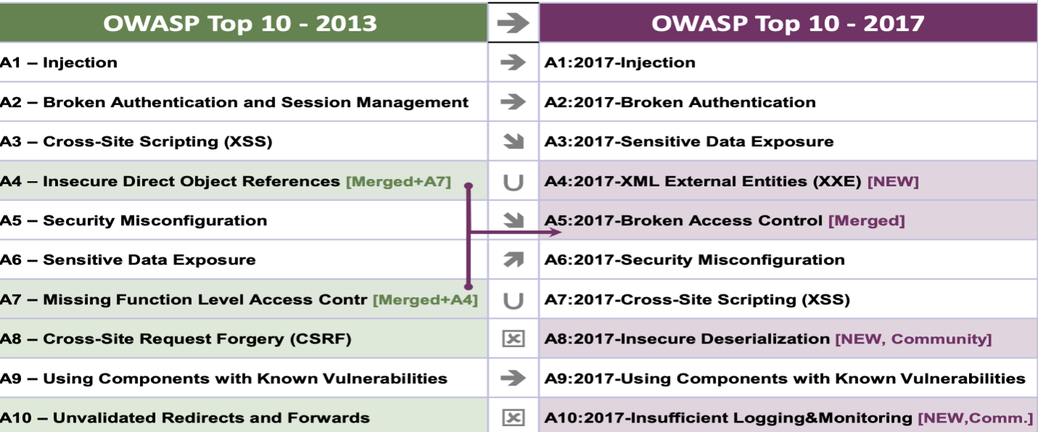
1. OWASP

Slide 8
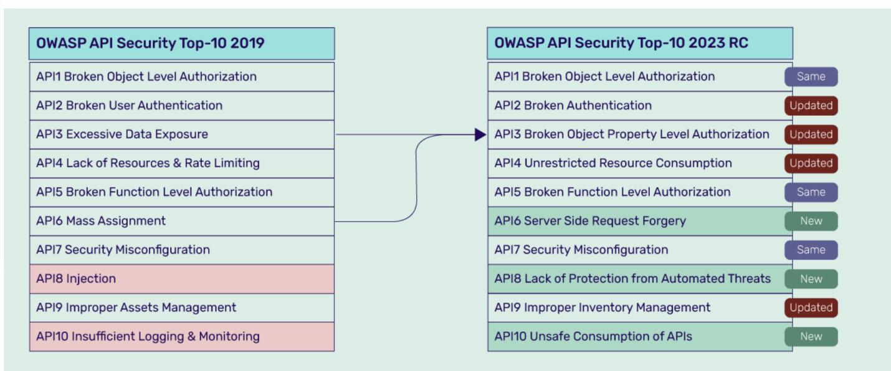
1. OWASP

Slide 9
1. OWASP
The OWASP Top 10 serves as a basic guideline for developers and web application security professionals to mitigate the most common security risks.
It's essential for secure coding practices and is often incorporated into corporate development and security standards.

Slide 10
1. OWASP
The OWASP Top 10 serves several key purposes in the realm of web application security.
Awareness and Education: The primary goal of the OWASP Top 10 is to raise awareness about the most common and critical security risks facing web applications. By educating developers, managers, and organizations about these risks, the Top 10 helps in prioritizing security efforts.

Slide 11
1. OWASP
Guideline for Secure Coding: The list provides a guideline for developers on secure coding practices. It highlights the areas that are most vulnerable to attack, helping developers understand and focus on securing these aspects in their code.
Risk Assessment and Management: Organizations use the OWASP Top 10 to assess the risks in their web applications and to develop a risk management strategy. It helps in identifying vulnerabilities that need immediate attention and in allocating resources effectively.

Slide 12
1. OWASP
Benchmark for Web Application Security: The OWASP Top 10 acts as a benchmark for evaluating the security of web applications. It provides a standard against which developers and security professionals can measure the security level of their applications.
Security Training and Certification: The list is often used as a training tool for educating developers and security professionals about application security. Many security training and certification programs include the OWASP Top 10 as a fundamental part of their curriculum.

Slide 13
1. OWASP
Development of Security Tools and Services: Security tool and service providers use the OWASP Top 10 to guide the development of their products. This ensures that their tools are effective in identifying and mitigating the most prevalent security risks.
Compliance and Policy Development: Some organizations and regulatory bodies use the OWASP Top 10 as a part of their compliance requirements. They may mandate that applications be free of the vulnerabilities listed in the Top 10.

Slide 14
1. OWASP
Fostering a Security Culture: The OWASP Top 10 helps in fostering a culture of security within development teams. It underscores the importance of security in the software development lifecycle and encourages the adoption of security best practices.

Slide 15
1. OWASP
If you are in a cybersecurity team, in all big companies around the world, especially if you work with pharmaceutical, military or banking, you will be tied and use the OWASP as a basics of all requirements that need to be implemented. A project that does not follow the set of rule will often be delayed or even discarded, and vendors solutions won’t be kept.
The OWASP is not just a list of information, it is also used as practical application.

Slide 16
1. OWASP
Secure Development Lifecycle Integration: Developers and software architects can integrate the OWASP Top 10 into the Software Development Lifecycle (SDLC) to ensure that security is considered at every stage of development. This includes implementing secure coding practices, performing code reviews, and conducting security testing that specifically addresses the vulnerabilities listed in the Top 10.

Slide 17
1. OWASP
Security Training and Education: The OWASP Top 10 serves as a foundational element in security training programs for developers, QA testers, and other IT professionals. It provides a clear and concise list of common security risks, making it an excellent tool for raising awareness and educating teams about web application security.

Slide 18
1. OWASP
Risk Assessment and Threat Modeling: Organizations can use the OWASP Top 10 as a framework for risk assessment and threat modeling. By understanding the most common threats, security teams can better identify potential vulnerabilities in their own applications and prioritize mitigation efforts.

Slide 19
1. OWASP
Security Testing and Auditing: Penetration testers and auditors use the OWASP Top 10 as a checklist to ensure comprehensive security testing of web applications. Tools like web vulnerability scanners often include checks specifically for vulnerabilities listed in the Top 10.

Slide 20
1. OWASP
Third-Party Vendor Assessment: When assessing third-party vendors or software, organizations can refer to the OWASP Top 10 to evaluate the security posture of the vendor's applications. This helps in ensuring that third-party products don’t introduce vulnerabilities covered in the Top 10 into the organization's environment.

Slide 21
1. OWASP
Regulatory Compliance and Policy Making: Some regulatory standards and organizational policies reference the OWASP Top 10 as a minimum standard for web application security. Adhering to the Top 10 can help organizations meet certain compliance requirements related to cybersecurity.

Slide 22
1. OWASP
Tool and Solution Development: Security solution providers use the OWASP Top 10 to guide the development of their products. This ensures that their tools are effective in identifying, preventing, and mitigating common web application vulnerabilities.

Slide 23
1. OWASP
Incident Response and Forensics: In case of a security breach, the OWASP Top 10 can help incident response teams in quickly identifying the types of vulnerabilities that might have been exploited and guide the forensic analysis.

Slide 24
1. OWASP
In summary, the OWASP Top 10 is a versatile tool that can be used in various aspects of web application security, from development and education to testing, compliance, and incident response.
Its widespread recognition and adaptability make it a valuable asset for enhancing the security posture of web applications.

Slide 25

Exercises

Slide 26
2. OWASP top 10

Slide 27
2. OWASP top 10
API1 Broken Object Level Authorization (BOLA)
BOLA vulnerabilities enable attackers to access data objects (access
to which should have been restricted) using unauthorized requests.
This leads to the exposure of data objects and, eventually, leakage,
modification, and destruction of data and other resources.

Slide 28
2. OWASP top 10
API2 Broken Authentication
Broken Authentication is a vulnerability that occurs when the API
does not properly authenticate its users, and the application is unable
to detect whether the user is legitimate or not.
As a result, the attacker can gain partial or full control over the API,
app, and its resources. These OWASP API Top 10 2023 vulnerabilities
make the API prone to brute force attacks, credential stuffing
attacks, etc.

Slide 29
2. OWASP top 10
API3 Broken Object Property Level Authorization
All users need not have access to all object properties. For accessing
certain object properties, the user must verify themselves and
validate their access permissions.
The Broken Object Property Level Authorization vulnerability
extends unrestricted access to object properties that should have
been restricted. So, attackers can access, modify, add, and delete
property values to objects.

Slide 30
2. OWASP top 10
API4 Unrestricted Resource Consumption
Resources are at the core of APIs; APIs cannot function without
resources. However, the existence of resources also brings a whole
range of API security risks since it programmatically exposes
resources. Without proper limitations, attackers can overwhelm APIs
by sending multiple requests.
This leads to the degradation of services, DoS/ DDoS attacks,
performance latency issues, crashes, etc.

Slide 31
2. OWASP top 10
API5 Broken Function Level Authorization (BFLA)
APIs use function-level authorization to control access to specific
user functions and actions based on their privilege level. It ensures
that authorizations, verifications, and permission checks secure each
function and action.
Broken Function Level Authorization vulnerabilities arise in APIs
when these function-level authorizations fail, enabling attackers to
illegitimately access functions and features and perform restricted
actions like data/ feature modification or deletion, unauthorized
access, privilege escalation attacks, etc.

Slide 32
2. OWASP top 10
API6 Server-Side Request Forgery (SSRF)
Server-Side Request Forgery occurs when APIs process requests
from user-controlled URLs and fetch internal/ remote server
resources without validating the user request first.
So, attackers can access backend servers, including those protected
by firewalls, by simply manipulating the URL. They can access
sensitive information and engage in other malicious activities.

Slide 33
2. OWASP top 10
API7 Security Misconfiguration
Security misconfigurations in APIs occur when security best practices
aren’t properly followed and/or the security of the API stack isn’t
properly hardened.
Some examples of this vulnerability include unapplied latest patches,
unwanted exposure of debug logs, unpatched legacy options,
unnecessary features/ services, improper implementation of CORS
policy, unnecessary enabled HTTP Verbs, etc. Security
misconfigurations expose APIs to a whole host of security risks.

Slide 34
2. OWASP top 10
API8 Lack of Protection from Automated Threats
In this attack, attackers exploit business logic flows using botnets and
other automated tools to customize and scale attacks.
Attackers send seemingly legitimate requests that exploit the
business logic. Every attack is unique and context-driven, making
these hard to detect and protect against.

Slide 35
2. OWASP top 10
API9 Improper Inventory Management
Improper Inventory Management security risk occurs because
organizations have multitudes of internal and third-party APIs that
are improperly inventoried, documented, and managed. Some
examples of these vulnerabilities include multiple versions of APIs
being used, exposure of development APIs, improper access control
policies, etc.
Improper inventory management exposes APIs, business logic, and
resources. The lack of visibility also creates more vulnerabilities, such
as security misconfigurations, poor authorization, authentication,
etc.

Slide 36
2. OWASP top 10
API10 Unsafe Consumption of APIs
Developers often trust data received, especially while working with
reputed third-party providers and suppliers and deploy less stringent
security policies and standards.
For instance, they may not restrict permissions, adequately validate
data/ inputs, and have lax authentication and authorization policies.
Developers leave their APIs and resources vulnerable to breaches
and attacks if attackers can hack third-party providers and suppliers.

Slide 37
Exercises

